Slide 1
Please make the task correspond to the condition. i.e. a “bank savings account/life insurance policy/home loan plan”
Please also add in a rule that respondents must answer every question before they can click "Next"

Slide 2
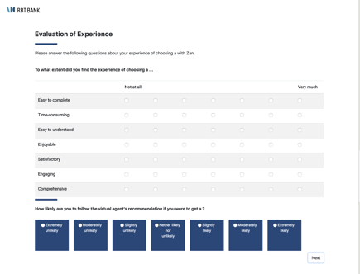
When I preview the survey pages on appspot…
3
But then I press ”Next”, I get to this page, which is wrong.
1
This is the first page I get, which is correct.
4
When I press “Next” again, I go back to this again, and steps 3. and 4. repeats themselves.
Can there be a page which says: “Thank you for completing the evaluation survey. Your verification code is “XXX”, please enter it into the conversation with the virtual assistant to continue the conversation.”
2
When I press “Next”, I get to this page, which is correct.

Slide 3
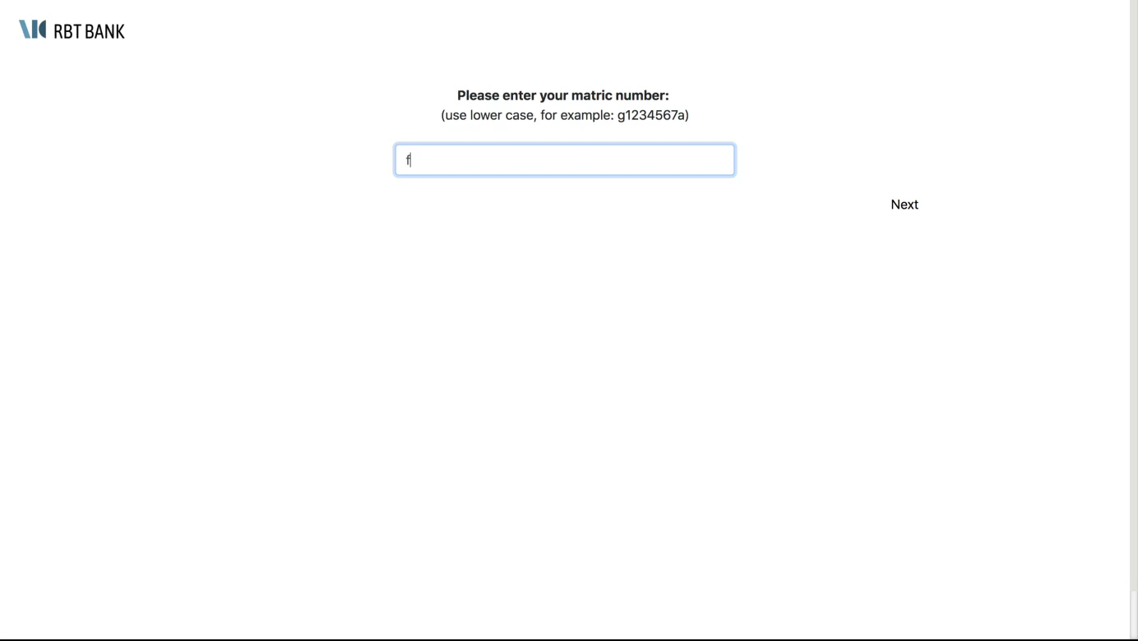
when I press the Next button to go from the intro page into the chat, the picture of the avatar will appear for a split second, even though this pilot condition should have no avatar at all (at about 00.01s)
the chat animation is supposed to appear like a natural conversation. Currently, all the chat bubbles appear at once, and sometimes the respondent's chat bubble buttons appear even before the avatar's --> that makes it look very obvious that everything is programmed and artificial (at about 00.06s)

Slide 4
Summary of Feedback -- 03.07.18
Conversation section
Chat bubbles animation:
There seems to be a delay in timing, but this applies uniformly across all chat bubbles? Instead, it should be the case where shorter chat bubbles have shorter duration; longer chat bubbles have longer duration
The original duration is fine for the shorter lines of text
Chat bubbles are still not appearing one after another
Font and style of conversation should match Neutral/Woman/Man script. But responses from respondents should always be kept as the "Neutral" font, regardless of condition
Survey section
Survey:
Ensure respondent answers every question before they can click “Next”
Display “bank savings account/life insurance policy/home loan plan” for both survey questions page 1 & 2, corresponding to the condition
Solve survey pages issue such that the “Next” buttons won’t lead into an endless loop.
There can be a page which says: “Thank you for completing the evaluation survey. Your verification code is “XXX”, please enter it into the conversation with the virtual assistant to continue the conversation.”
Final page
Additional final page to display unique ID and redirect to external page
Can model after Yihan’s project

